Slide 1
Validation

Slide 2
Mobile Validation

Slide 3
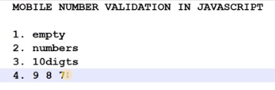

Slide 4
Text Validation

Slide 5
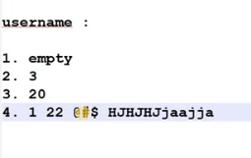

Slide 6
Password Validation

Slide 7


